Slide 2
Priority Queue
A collection of prioritized elements that allows arbitrary element insertion,
allows the removal of the element that has first priority.
When an element is added to a priority queue,
the user designates its priority by providing an associated
key.
The element with the minimal
key will be the next to be removed
from
the queue

Slide 3
Priority Queue- Unsorted list
Doubly Link list is used to store <k,v> in PQ.
Insert -> at the end of the list
removeMin -> search for all items in list to find the minimum key

Slide 4
Priority Queue- Sorted list
Doubly Link list is used to store <k,v> in PQ.
Items are sorted in the list in non-decreasing order
The first item has maximum priority
Insert -> start from end, scan backward
removeMin -> remove first item
<1,C>,<2,A>,<4,B>

Slide 5
Priority Queue
Order : We need to retrieve the event with the smallest time stamp
Time stamp can be consider as the key and flight no as value

Slide 6
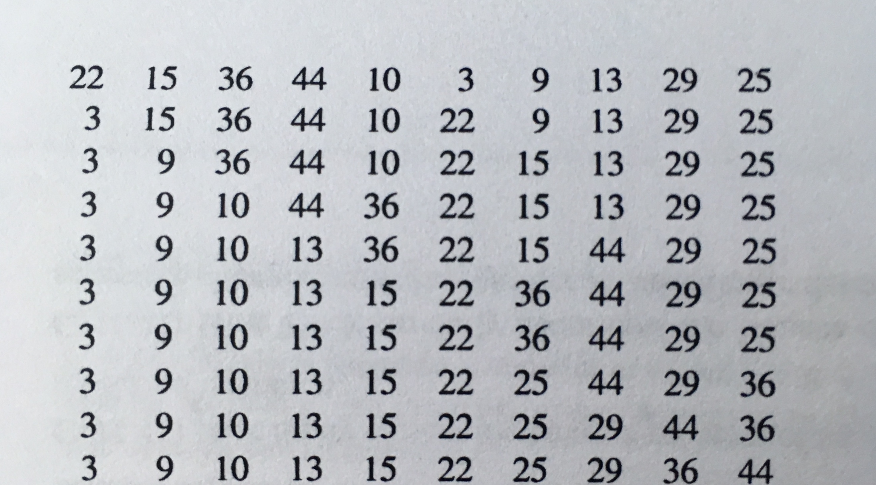

Slide 7
Priority Queue: Selection Sort
Selection Sort: at each step we select the next minimum.
Similar to Priority Queue – Unsorted list
Phase I : Insert all items from S to PQ
Phase II: removeMin from PQ and
add to the end of S.

Slide 8
Priority Queue: Insertion Sort
Insertion Sort: at each step we Insert the item in its appropriate place.
(keep the sub list sorted)
Similar to Priority Queue –sorted list

Slide 9
Input sequence is in decreasing order
44, 30, 22, 15, 12, 10, 3
44
30,44
22,30,44
15,22,30,44
10,15,22,30,44
3, 10,15,22,30,44
For each Item we start from end, moves backward and Insert at the beginning
O(n^2)

Slide 10
Heap
Heap-Order Property: In a heap T, for every position p other than the root, the key stored at p is greater than or equal to the key stored at p’s parent.
Complete Binary Tree Property: A heap T with height h is a complete binary tree if levels 0,1,2, . . . ,h−1 of T have the maximal number of nodes possible (namely, level i has 2i nodes, for 0 ≤ i ≤ h−1) and the remaining nodes at level h reside in the leftmost possible positions at that level.

Slide 11
If the smallest is at the top of the heap, the largest key in a heap may be at any external node (child, leaf)

Slide 12
BST
each internal position p stores a key-value pair (k,v) such that:
Keys stored in the left subtree of p are less than k.
Keys stored in the right subtree of p are greater than k.

Slide 13
1
2
3
4
5

Slide 14
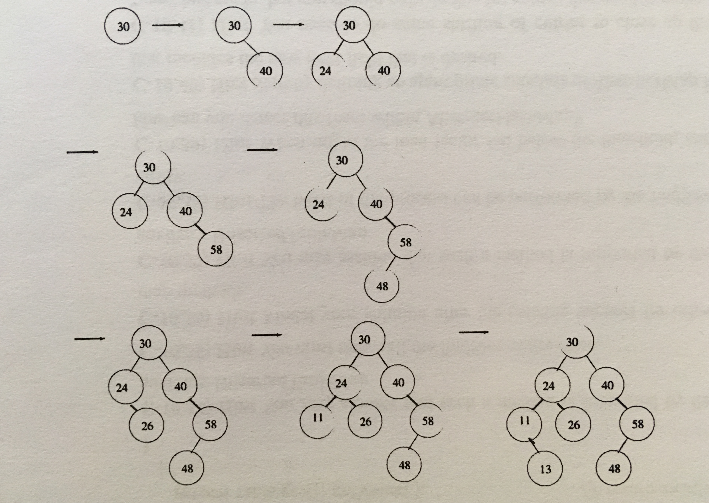
Insert, into an empty binary search tree, entries with keys 30, 40, 24, 58, 48, 26, 11, 13

Slide 15
Merge Sort O(nlog n)
Quick Sort O(n)
At first we choose a pivot then rearrange the items such that :
All item on the left side of the pivot <= pivot
All items on the right side of the pivot >= pivot
=>> O(n) => done!

Slide 16
An input list that is already sorted
If we reverse the input:
Marge-sort , heap-sort -> O(n log n)
Insertion-sort -> O(n^2)

Slide 17
Graph Representations
In an edge list, we maintain an unordered list of all edges. This minimally suffices, but there is no efficient way to locate a particular edge (u,v), or the set of all edges incident to a vertex v.

Slide 18
Graph Representations
In an adjacency list, we additionally maintain, for each vertex, a separate list containing those edges that are incident to the vertex. This organization allows us to more efficiently find all edges incident to a given vertex.

Slide 19
Graph Representations
An adjacency map is similar to an adjacency list, but the secondary container of all edges incident to a vertex is organized as a map, rather than as a list, with the adjacent vertex serving as a key. This allows more efficient access to a specific edge (u,v), for example, in O(1) expected time with hashing.

Slide 20
Graph Representations
An adjacency matrix provides worst-case O(1) access to a specific edge (u,v) by maintaining an n×n matrix, for a graph with n vertices. Each slot is dedicated to storing a reference to the edge (u,v) for a particular pair of vertices u and v; if no such edge exists, the slot will store null.

